Slide 1

Data Analysis for Community Impact: Indigenous Data Sovereignty, Grant Applications and Reporting, and Community Decision-Making

Slide 2
Agenda
Data Ethics and Sovereignty
Introduction to Data Analysis
Data Analytics Demo
Using Data to Support Community Funding and Reporting

Slide 3


Ethical Data Handling
Ethical Collection, Usage, and Dissemination

Slide 4
Ethical Data Handling Considerations
Collect data with a clear purpose
Be transparent about how data will be used
Ensure participation is voluntary and informed
Collect only what is necessary
Protect privacy and confidentiality
PHIA (Personal Health Information Act) and PIPEDA (Personal Information Protection and Electronic Documents Act) applies to how organizations collect, use, and share personal information
Requires consent, limited use, and protection of data

Slide 5
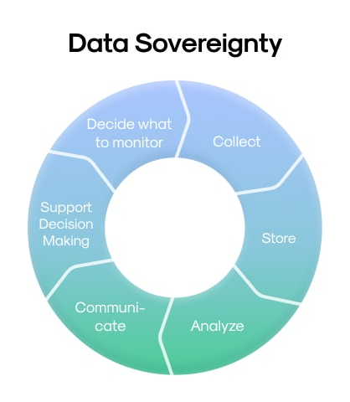
Indigenous Data Sovereignty

Slide 6
Indigenous Data Sovereignty
What is it?
The right of Indigenous peoples to own, control, access, and manage their data
Why it Matters
Addresses historical misuse and extraction of Indigenous data, and instead ensures community benefit
Supports self-determination and community governance. Builds trust, transparency, and accountability
What This Means in Practice
Be clear and transparent about why data is being collected and seek informed and voluntary participation
Use data in ways that benefit the community
Avoid sharing or publishing data without permission and be mindful of privacy, especially in small communities
The First Nations principles of OCAP establish how First Nations' data and information will be collected, protected, used, or shared.
Notes:
Data should reflect community priorities, values, and needs. Communities decide how data is collected, used, shared, and stored
OCAP is an acronym for the principles of ownership, control, access, and possession.

Slide 7
Data Analysis
A Brief Introduction

Slide 8
What is data analysis?
Data analysis is the process of collecting, organizing, and examining data to identify patterns, answer questions, and support decision-making.
Data analysis works best with structured data (e.g., multiple choice, categories, numerical values)
Structured data makes it easier to:
summarize results
compare groups
identify trends
Open-ended responses (e.g., suggestions, comments) are still valuable, but are more difficult to analyze at scale

Slide 9
Tools and Resources for Beginner Data Analysis
Python: For analyzing data
Use an IDE such as Visual Studio Code or an online complier such as replit
Free Python learning resource
PowerBI: For visualizing data
Free Power BI learning resource
Excel: For data handling and visualization
Free Excel learning resource
SQL: For database handling
Free SQL learning resource
Other useful tools include SAS, Tableau, R, Machine Learning, and more.

Slide 10
Data Analysis Process Overview
Define the Question: Identify the question you’d like to solve.
Collect the Data: Gather the raw data through surveys or records.
Clean the Data: Clean the data to remove errors or outliers.
Data Analysis: Start with exploratory data analysis (EDA) by calculating summary statistics (e.g., mean, median, standard deviation). Use descriptive statistics to summarize the data, inferential techniques (e.g., correlations, comparisons, regression) to draw conclusions, and, for more advanced analysis, use machine learning models such as clustering, classification, or forecasting to group data, make predictions, or identify patterns.
Visualization & Insights: Use charts, graphs, and reports to summarize the data to aid in interpretation and decision-making.

Slide 11
Data Analysis Demo
From Cleaning to Actionable Insights

Slide 12
The Dataset
This workshop uses a fictional dataset representing a powwow event with 950 attendees and 150 voluntary survey responses. The dataset was intentionally designed to reflect realistic patterns in attendance, engagement, and community impact. All data included is fully anonymized, meaning:
No personally identifiable information (PII) is collected or used
No real community data is disclosed
In this fictional example, the data is collected voluntarily and used by an indigenous-run organization. This approach aligns with key principles of data privacy and Indigenous Data Sovereignty, including:
Respect for community ownership and control of data
Avoidance of extracting or misusing real community information
Ethical use of data for learning, capacity-building, and decision-making

Slide 13
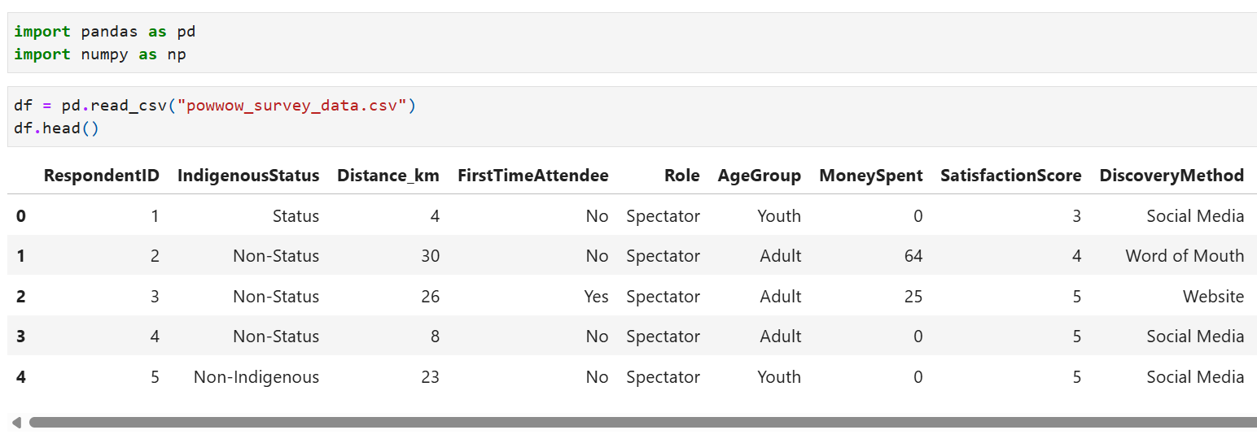
Importing python libraries and the dataset
Import any useful python libraries
Load and preview the dataset

Slide 14
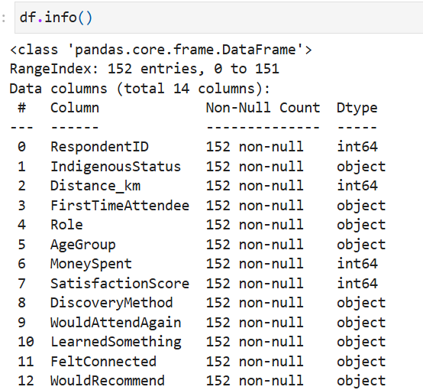
Exploring the Data
Review the structure of the dataset
Identify key variables (age, distance, spending, etc.)
Look for patterns and potential issues
Ask: What questions can this data help answer?

Slide 15
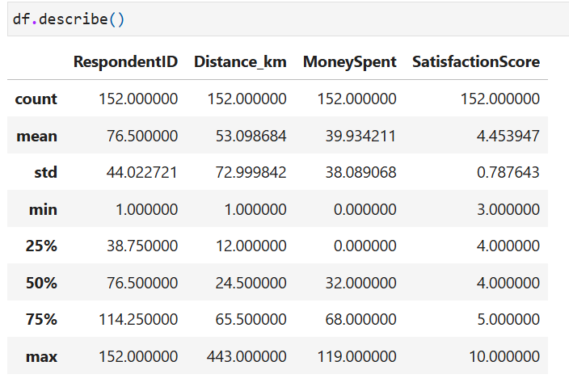
Exploring the Data
It is important to review the data at a high-level to check for any errors or inconsistencies, as well as to view an early trends.
Here, we see that the maximum value entered for Satisfaction Score was 10. However, the given range was 1-5 so this needs to be addressed before further analysis is completed.

Slide 16
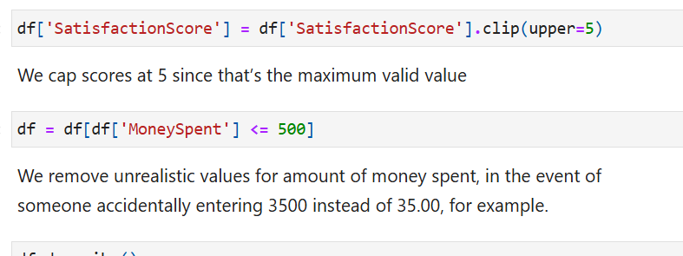
Cleaning the Data
Remove or correct invalid values
Cap satisfaction scores at valid range (1–5)
Remove extreme outliers (e.g., incorrect spending values)
Ensure consistency across categories

Slide 17
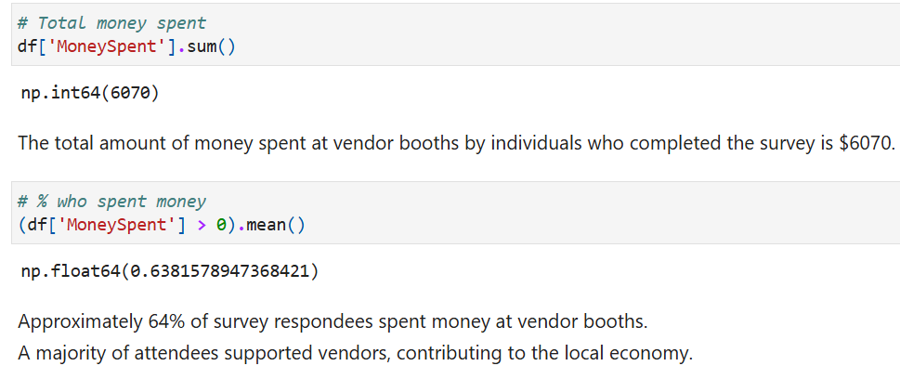
High-level Insights
What percentage of attendees spent money?
How much money was spent at vendor booths?

Slide 18
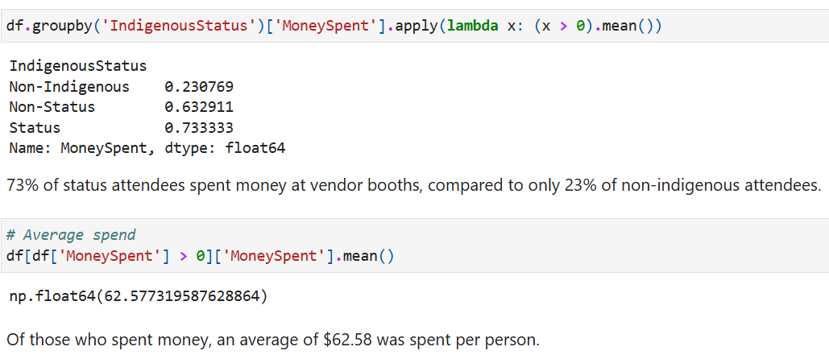
Analyzing the Financial Data
Differences in spending across groups
Contribution to local Indigenous vendors
Identifying high-impact attendee groups

Slide 19
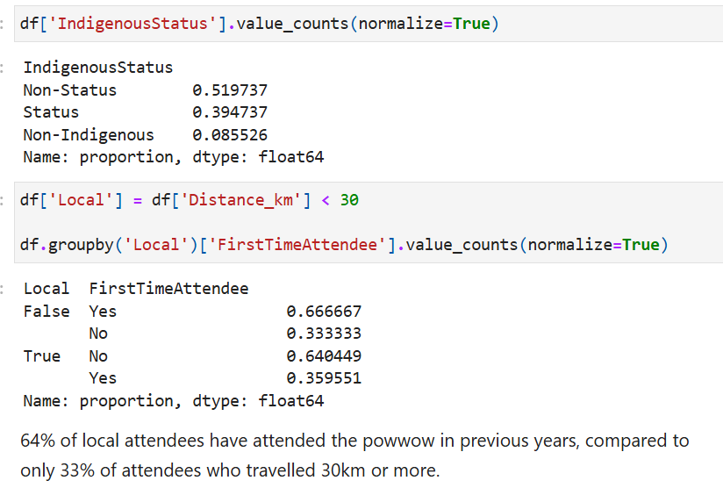
Analyzing Attendee Demographics
Demographic group distribution
First-time vs repeat attendees
Local vs non-local attendance

Slide 20
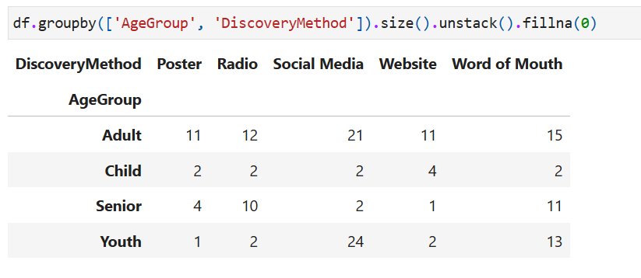
Spending Insights
How attendees heard about the event
Differences by age group
Identifying effective outreach channels
Informing future marketing strategies

Slide 21
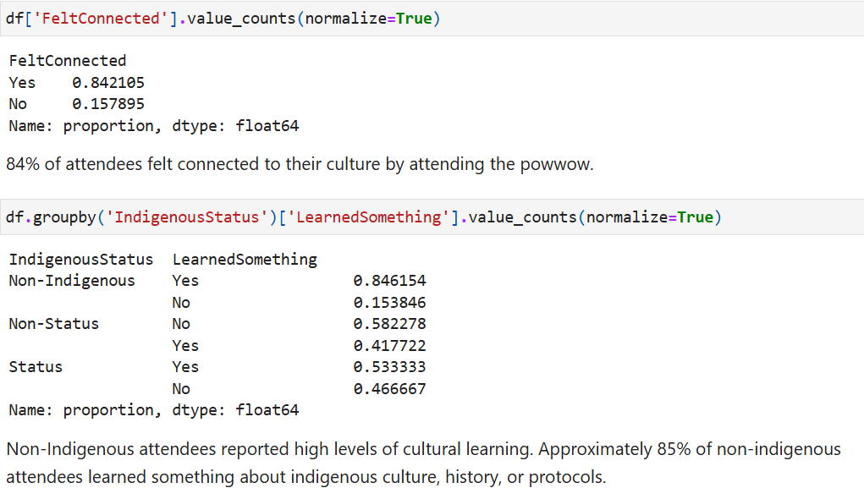
Overall Impact of the Event
Satisfaction levels across attendees
% who would attend again
Cultural learning among non-Indigenous attendees
Sense of community connection

Slide 22
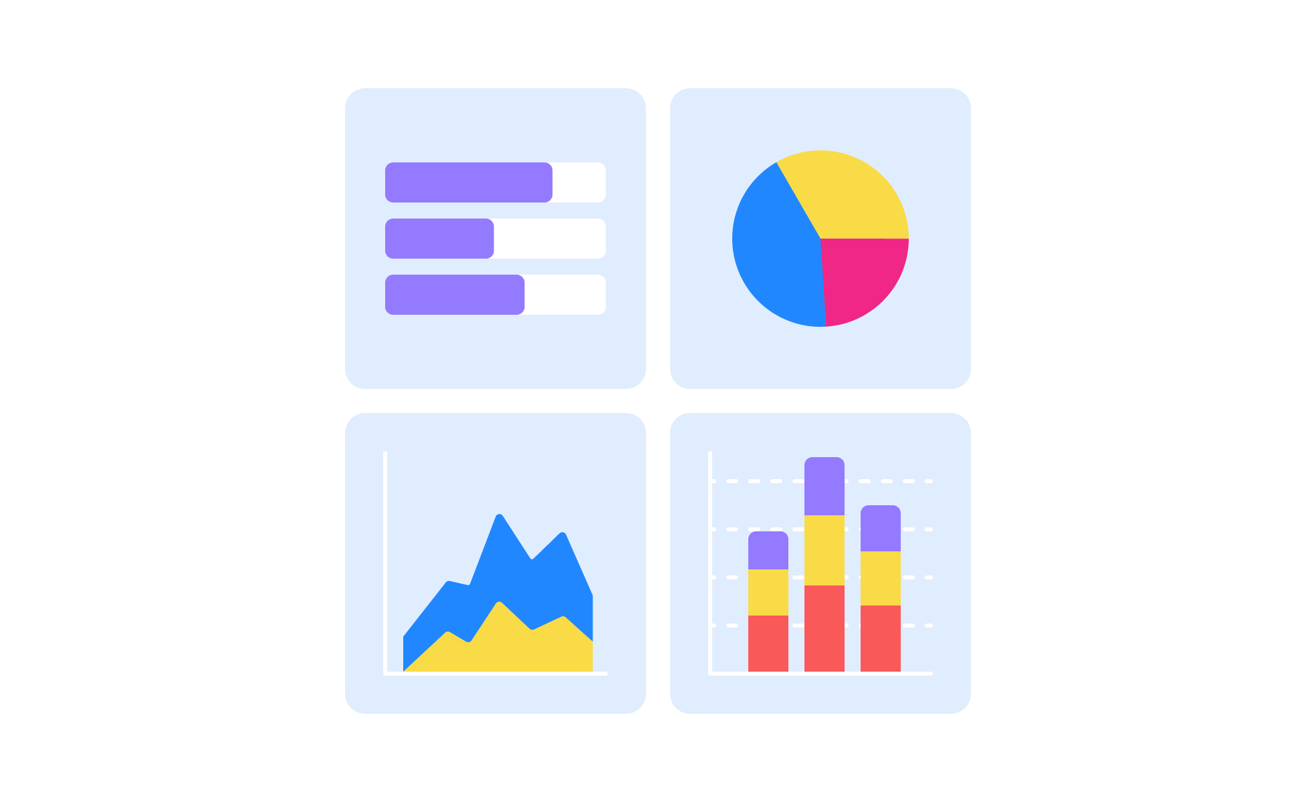
Why Visualization Matters
Raw data and tables can be difficult to interpret.
Data visualization helps:
communicate insights clearly
support decision-making
make data accessible to everyone

Slide 23
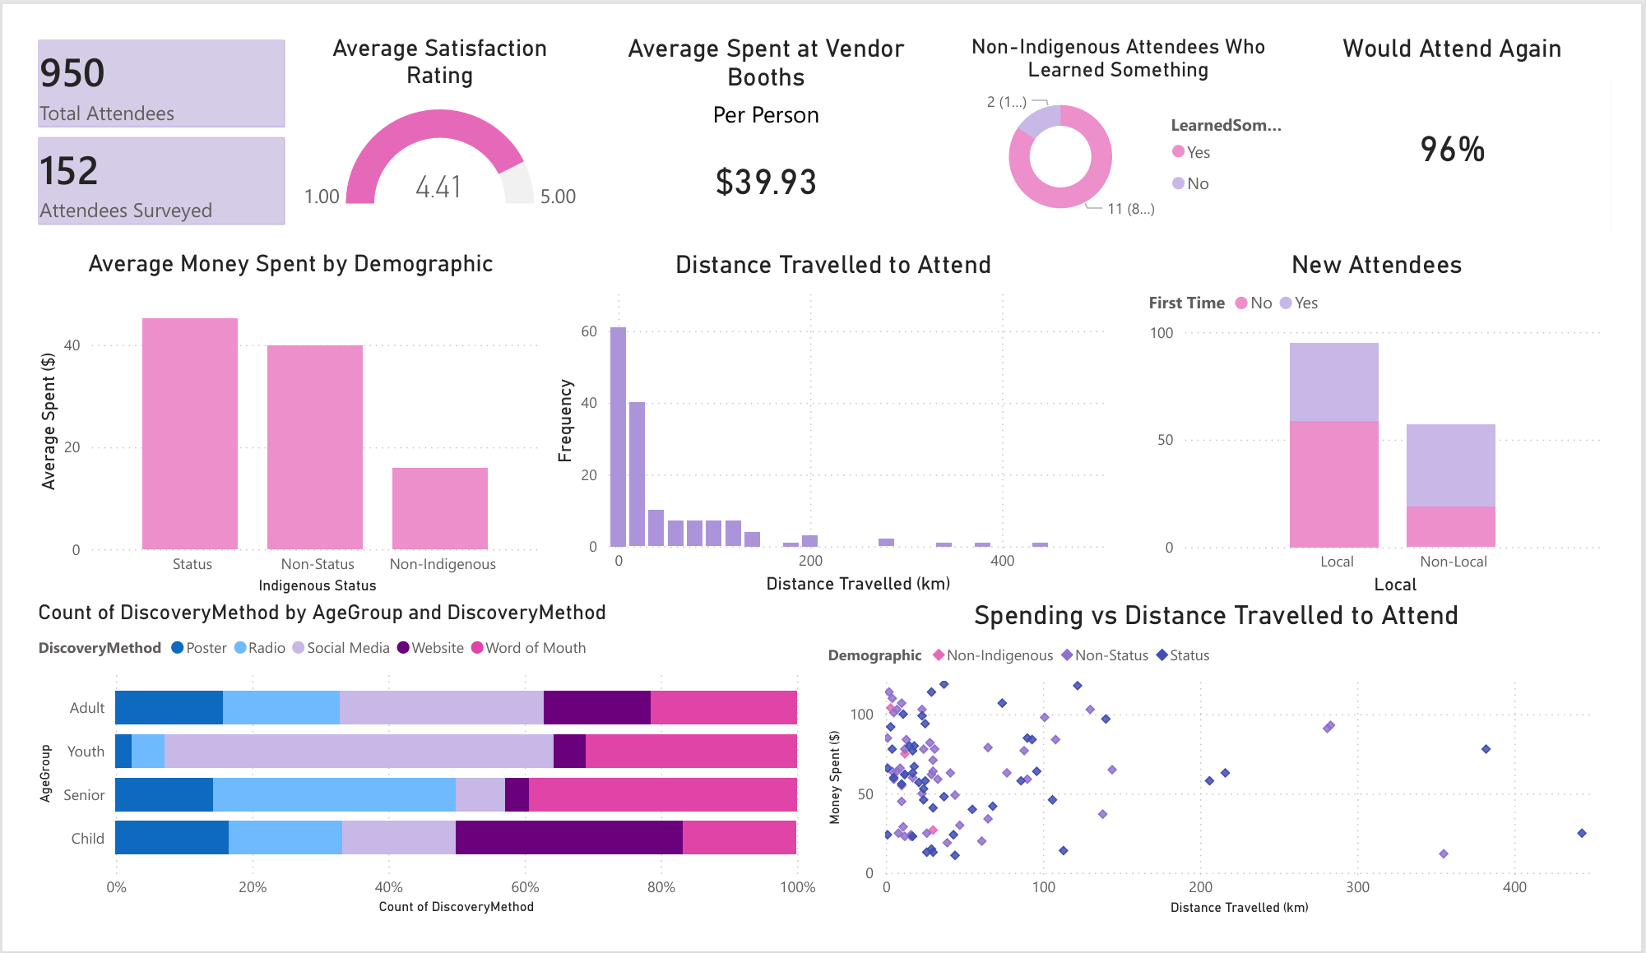
PowerBI Dashboard

Slide 24
From Data to Action
Vendor Insights
Strong vendor engagement and revenue → Attract more vendors for next year
Impact & Success
High satisfaction and community impact → Support grant reporting & future funding
Marketing Insights
Different groups respond to different outreach → Improve and target marketing strategies

Slide 25
Using Data to Support Community Initiatives
Why is it important and how can it help?

Slide 26
Funding Applications
Demonstrate attendance and growth
Show economic impact (vendor spending)
Highlight community reach
Provide evidence of cultural, social, or economic impact
Examples of Data You Can Include:
“Over 950 attendees, with 150 survey responses collected”
“65% of Indigenous attendees supported local vendors”
“Average satisfaction score of 4.6 out of 5”
“Attendees travelled from both local and regional communities”
“High engagement across youth, adult, and elder groups”

Slide 27
Post-Event Reporting
What You Can Show in Reports:
Attendance and participation breakdowns
Economic impact (vendor spending, local support)
Marketing effectiveness (how people heard about the program)
Cultural impact (learning, connection, community engagement)
Success metrics (satisfaction, return intent)
Summarize key metrics and outcomes
Report to funders and stakeholders
Identify strengths and areas for improvement
Support future planning and decision-making

Slide 28
Ideas For Useful Data to Collect:
Participation or engagement levels (e.g., attendance, usage, involvement)
Demographic groupings (e.g., age range, region, role)
First-time vs repeat participation
How participants heard about the initiative
Satisfaction or experience ratings (e.g., 1–5 scale)
Outcomes or impact indicators (e.g., learning, connection, skills gained)
Optional economic indicators (e.g., spending ranges, resources use)

Slide 29
Final Tips & Takeaways
Data doesn’t need to be complex to be useful
Even simple analysis can support strong decisions
Visualizations help to communicate impact
Ethical data practices are essential
Tips for Collecting & Handling Data
Keep surveys short to encourage participation
Clearly explain why you are collecting the data
Collect only what you need and avoid unnecessary personal information
Ensure participation is voluntary and based on informed consent
Use consistent categories (e.g., age groups, roles) for easier analysis
Avoid open-ended questions for analysis

Slide 30
Final Tips & Takeaways
Data Ethics and Sovereignty
Follow Indigenous Data Sovereignty principles
Ensure informed and ethical data collection
Use data responsibly and with community benefit and informed consent
Data Safety & Responsibility
Store data securely (password-protected files)
Avoid sharing raw data publicly or with third parties, even if anonymized
Be mindful of small communities where individuals may still be identifiable
Follow applicable privacy guidelines (e.g., PIPEDA)

Slide 31
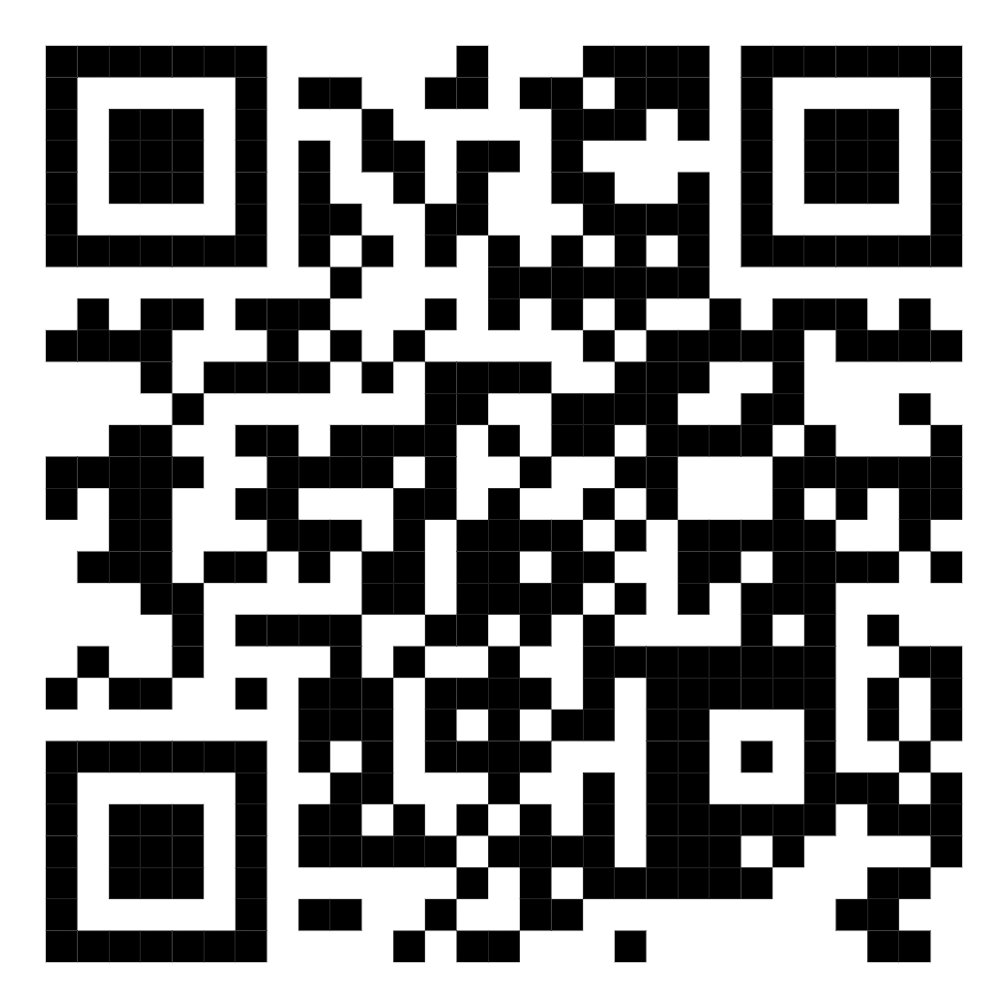

Thank you
Digital copy of the slideshow

